Slide 1

Billionaires Statistic Analysis with SQL & Excel

Slide 2

INTRODUCTION
This dataset contains statistics on the world's billionaires, including information about their businesses, industries, and personal details. It provides insights into the wealth distribution, business sectors, and demographics of billionaires worldwide.

Slide 3
KEY WORDS OF DATA
rank: The ranking of the billionaire in terms of wealth.
finalWorth: The final net worth of the billionaire in U.S. dollars.
category: The category or industry in which the billionaire's business operates.
personName: The full name of the billionaire.
age: The age of the billionaire.
country: The country in which the billionaire resides.
city: The city in which the billionaire resides.
source: The source of the billionaire's wealth.
industries: The industries associated with the billionaire's business interests.
selfMade: Indicates whether the billionaire is self-made (True/False).
gender: The gender of the billionaire.

Slide 4
KEY WORDS OF DATA
birthDate: The birthdate of the billionaire.
lastName: The last name of the billionaire.
firstName: The first name of the billionaire.
birthYear: The birth year of the billionaire.
birthMonth: The birth month of the billionaire.
birthDay: The birth day of the billionaire.
cpi_country: Consumer Price Index (CPI) for the billionaire's country.
gdp_country: Gross Domestic Product (GDP) for the billionaire's country.
life_expectancy_country: Life expectancy in the billionaire's country.
tax_revenue_country_country: Tax revenue in the billionaire's country.
total_tax_rate_country: Total tax rate in the billionaire's country.
population_country: Population of the billionaire's country.

Slide 5
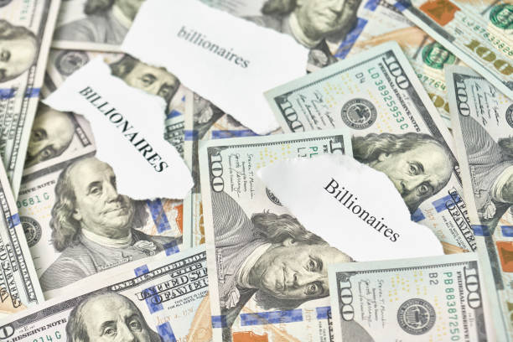
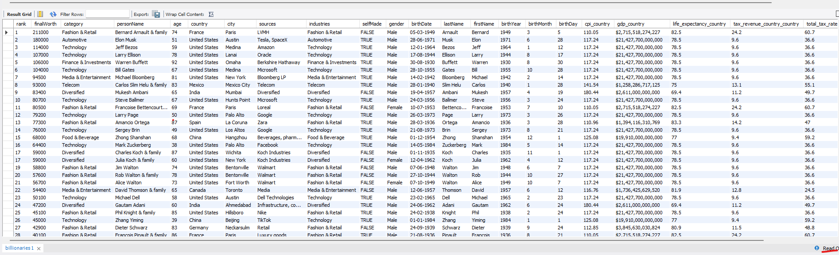
Select Billionaires Data
select * from billionaries ;

Slide 6
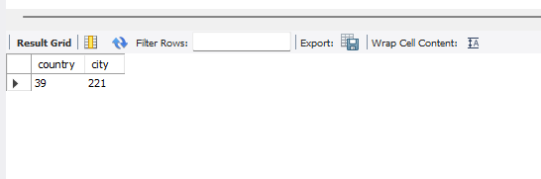
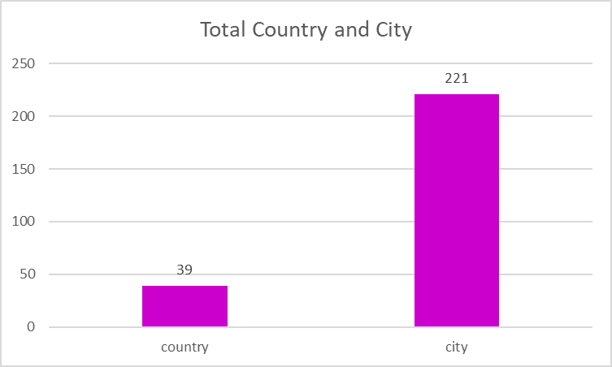

\
Total Country & City
select count(distinct country)as country,count(distinct city) as city from billionaries;

Slide 7
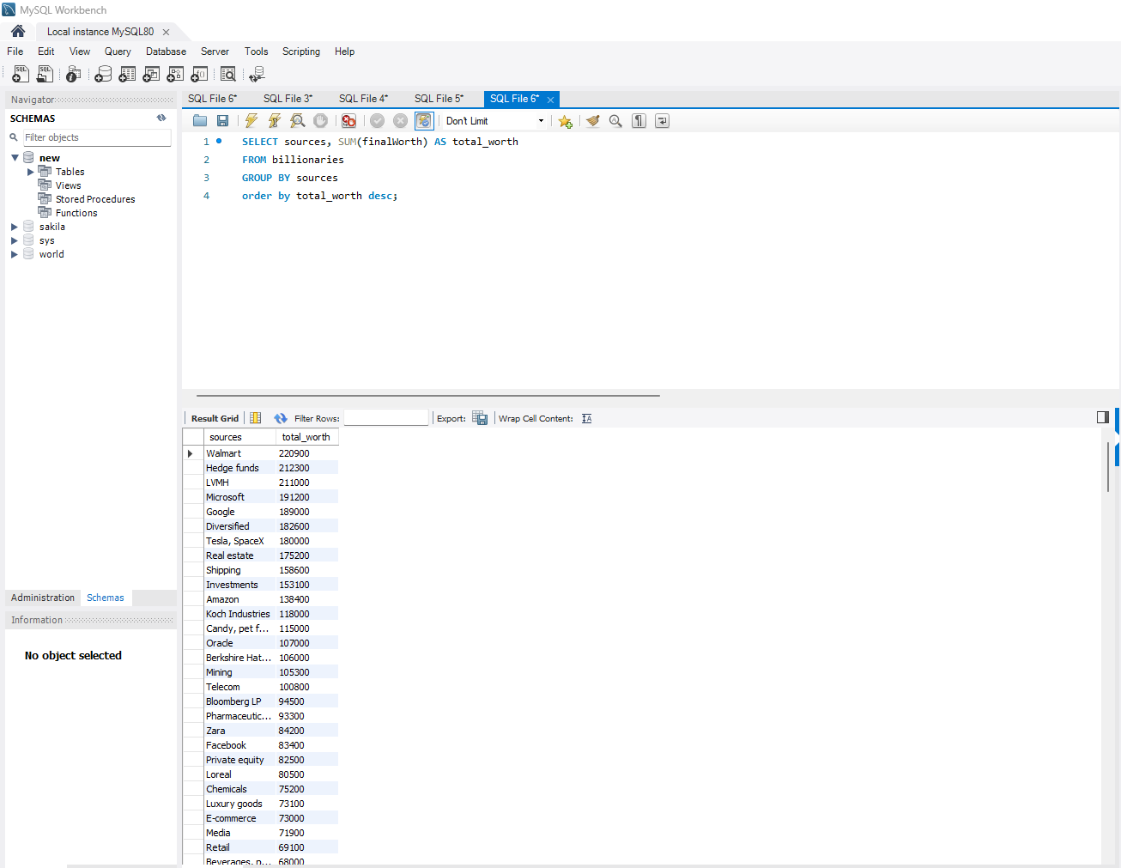
Source Based on Worth
SELECT sources, SUM(finalWorth) AS total_worth
FROM billionaries
GROUP BY sources
order by total_worth desc;

Slide 8
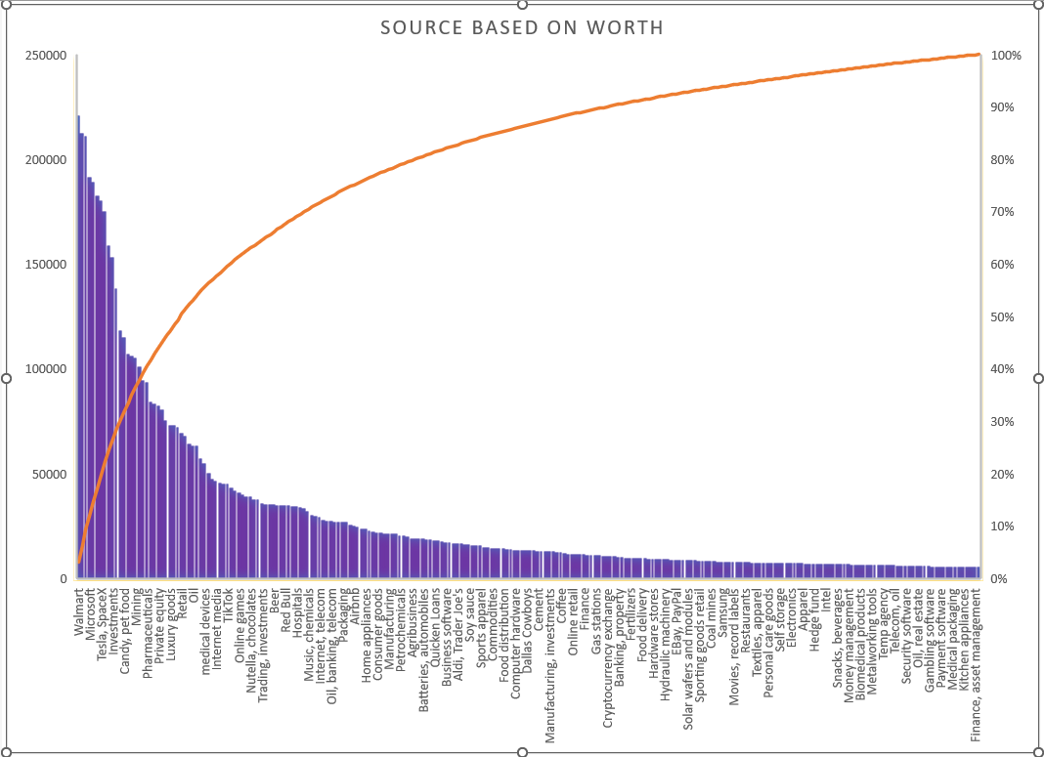
Source Based on Worth- Charts

Slide 9
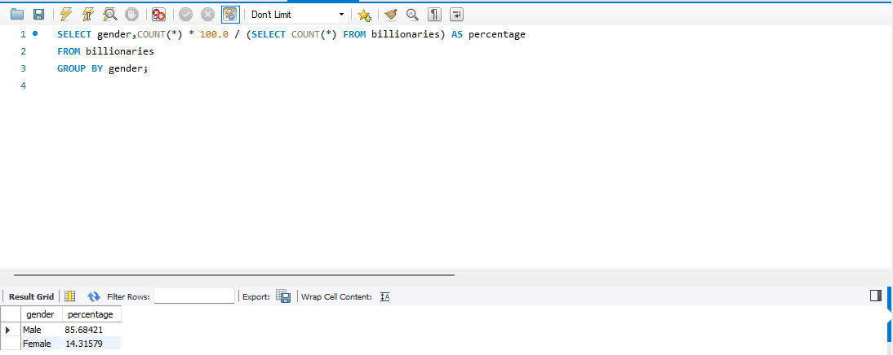
Proportion of Gender
SELECT gender,COUNT(*) * 100.0 / (SELECT COUNT(*) FROM billionaries) AS percentage
FROM billionaries
GROUP BY gender;

Slide 10
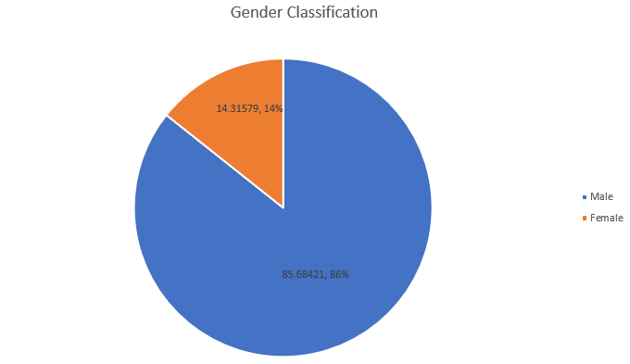
Proportion of Gender - Charts

Slide 11
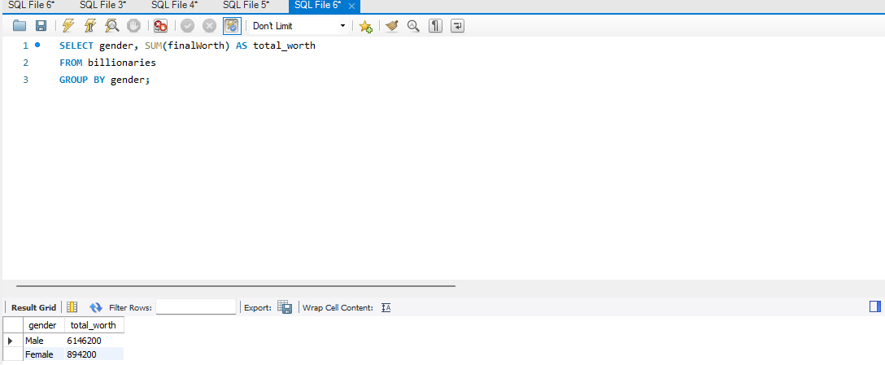
Male &Female Worth
SELECT gender, SUM(finalWorth) AS total_worth
FROM billionaries
GROUP BY gender;

Slide 12
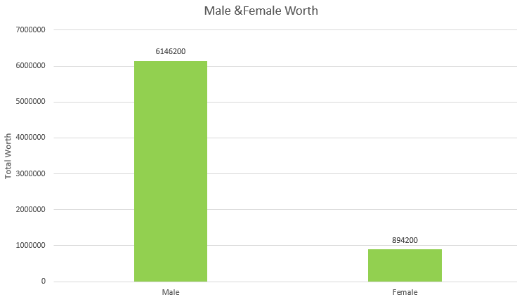
Male &Female Worth - Charts

Slide 13
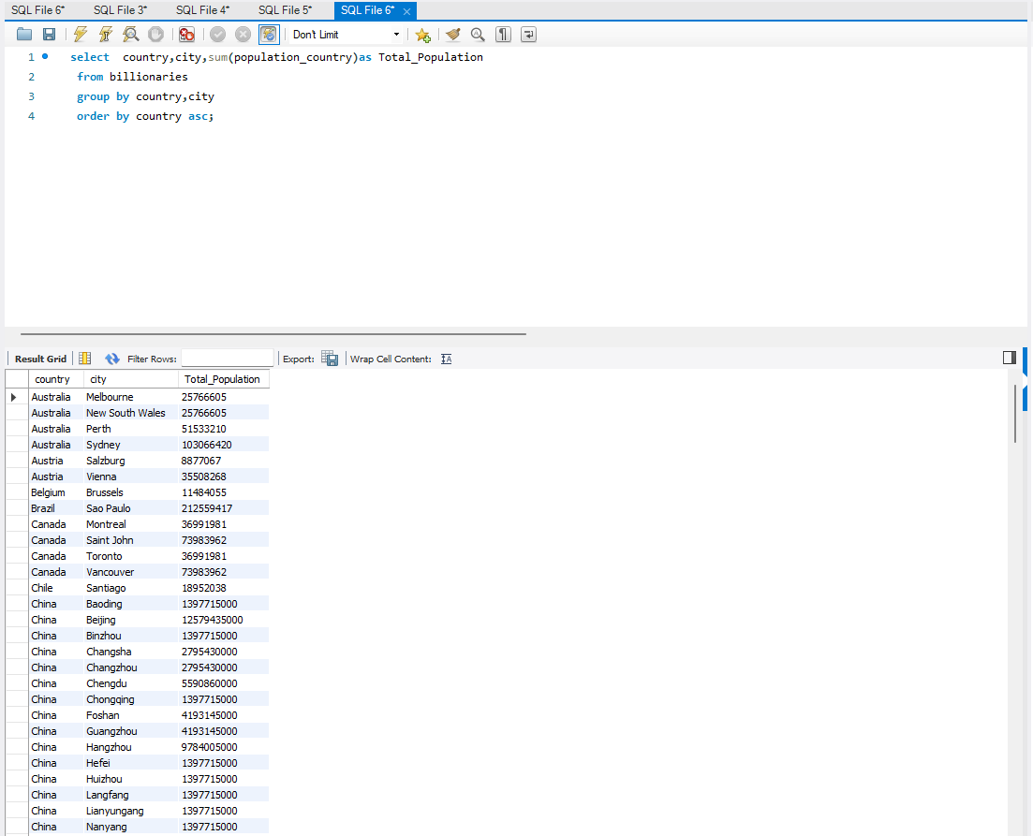
Total Population by country & city
select country,city,sum(population_country)as Total_Population from billionaries
group by country,city
order by country asc;

Slide 14
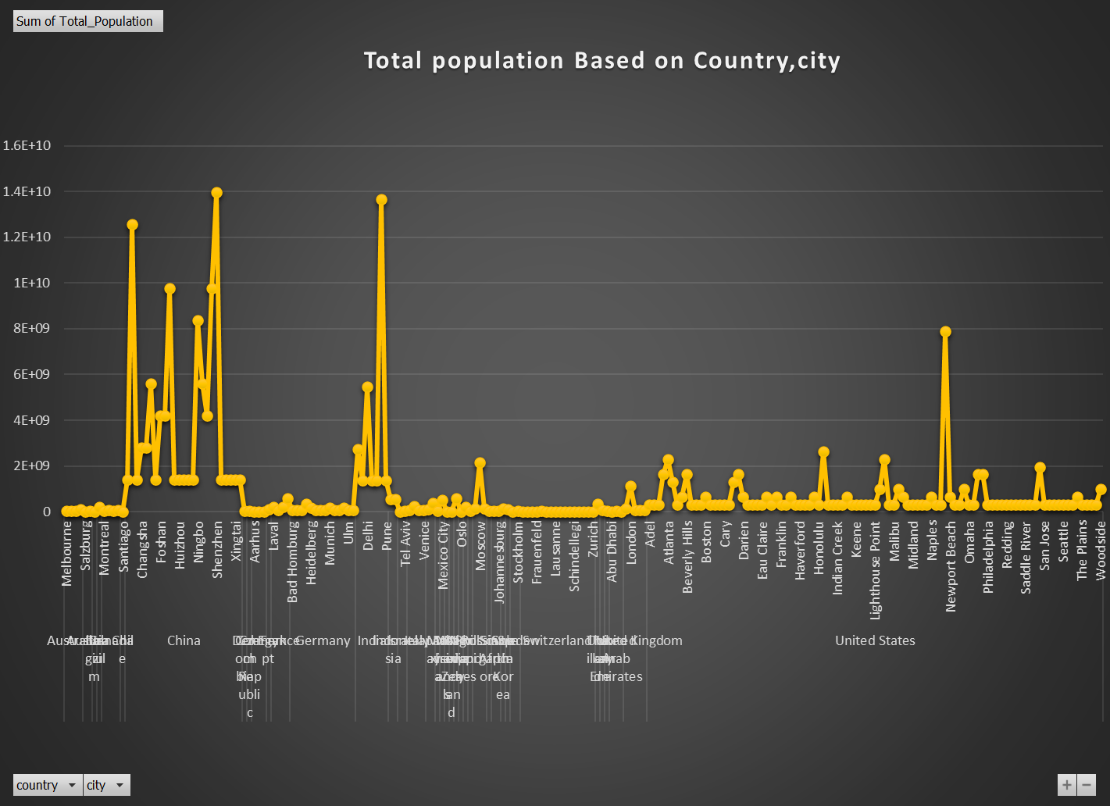
Total Population by country & city- Charts

Slide 15
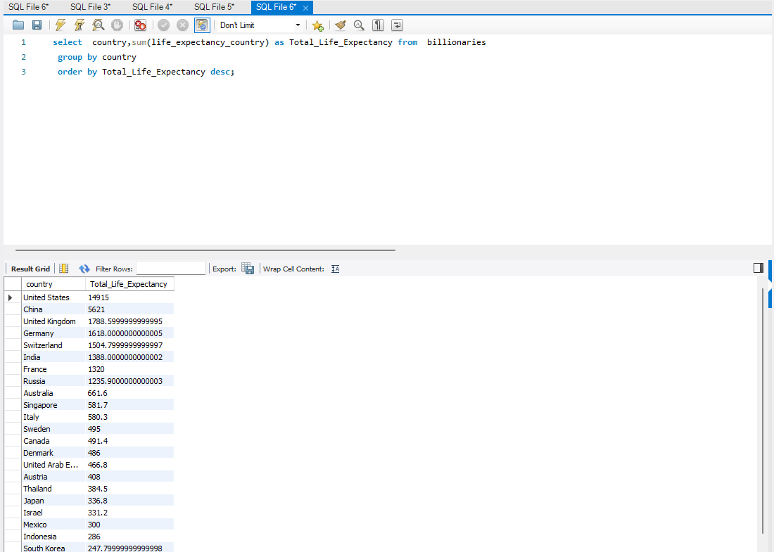
Total life Excepted by country
select country,sum(life_expectancy_country) as Total_Life_Expectancy from billionaries
group by country
order by Total_Life_Expectancy desc;

Slide 16
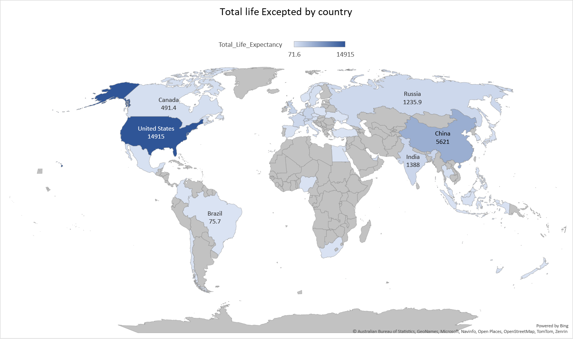
Total Population by country & city- Charts

Slide 17
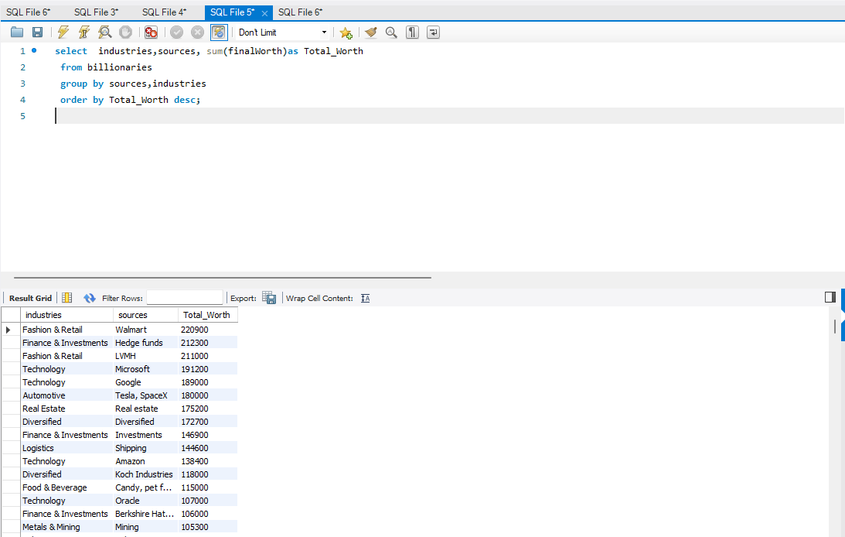
Industries source and worth
select industries, sources, sum(finalWorth)as Total_Worth from billionaries
group by sources,industries
order by Total_Worth desc;

Slide 18
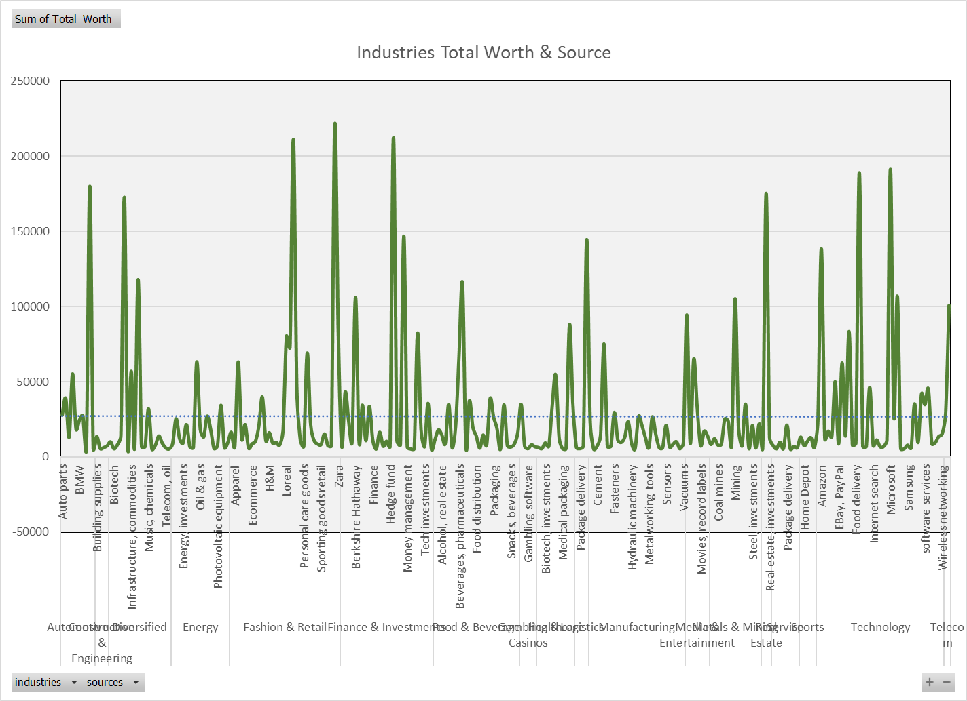
Industries source and worth - Charts

Slide 19
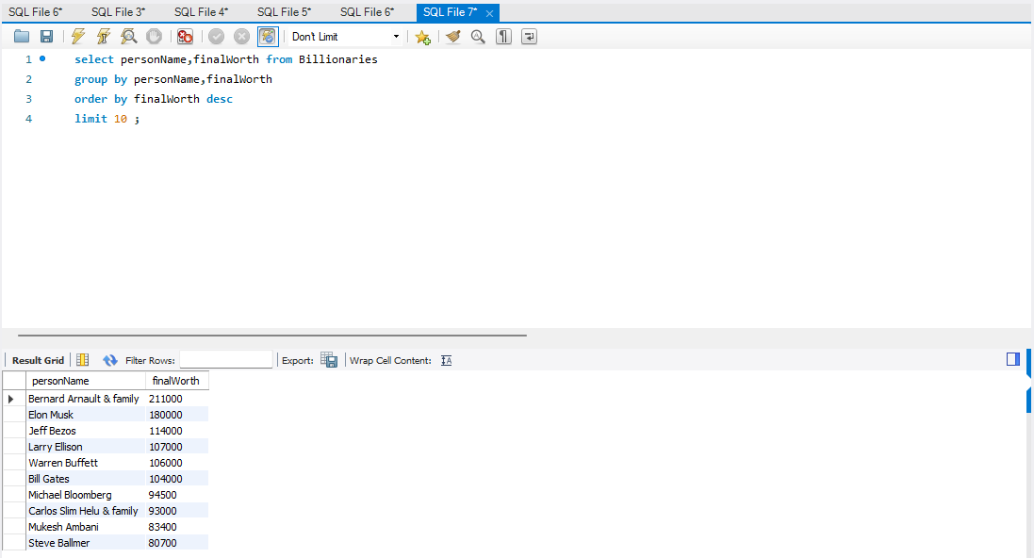
Top 10 Person’s Worth
select personName,finalWorth from Billionaries
group by personName,finalWorth
order by finalWorth desc
limit 10 ;

Slide 20
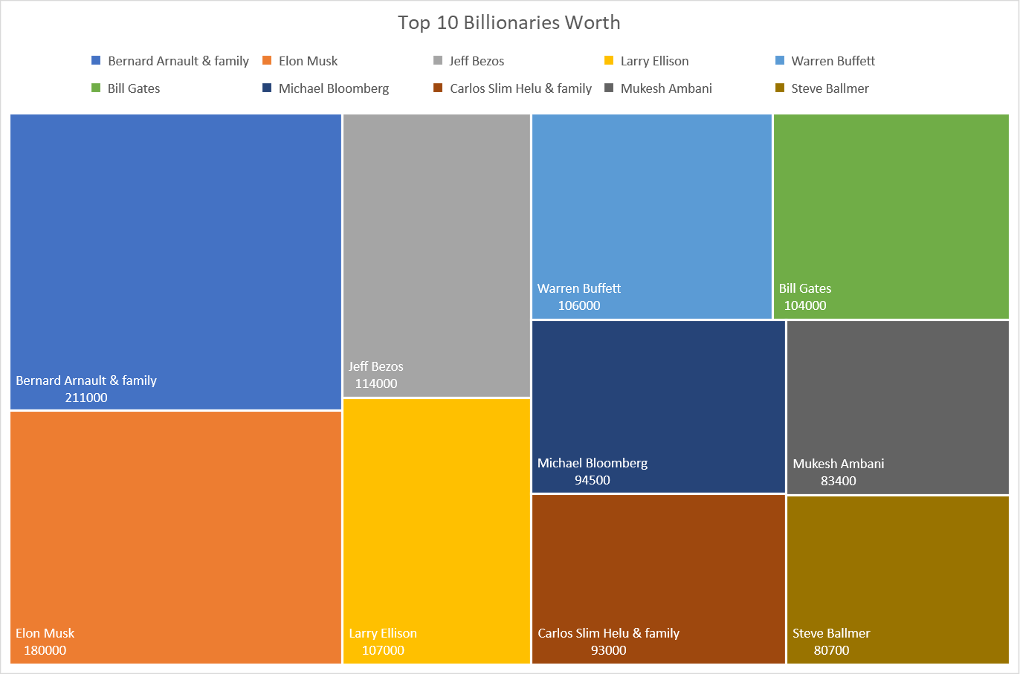
Top 10 Person’s Worth - Charts

Slide 21
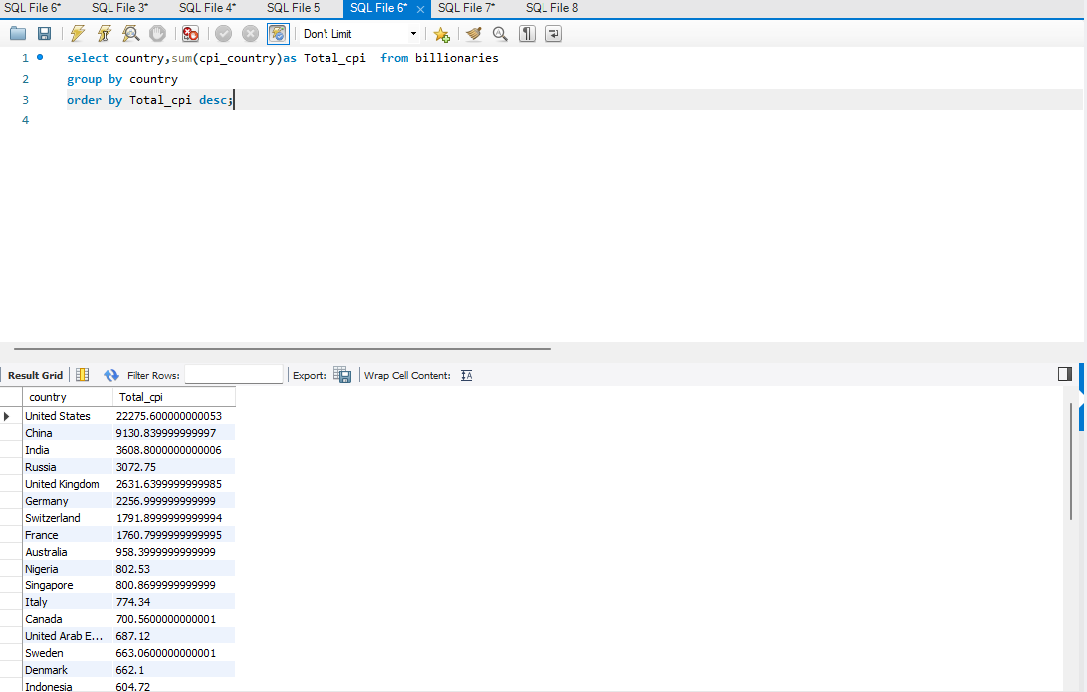
CPI by Country
select country,sum(cpi_country)as Total_cpi from billionaries
group by country
order by Total_cpi desc;

Slide 22
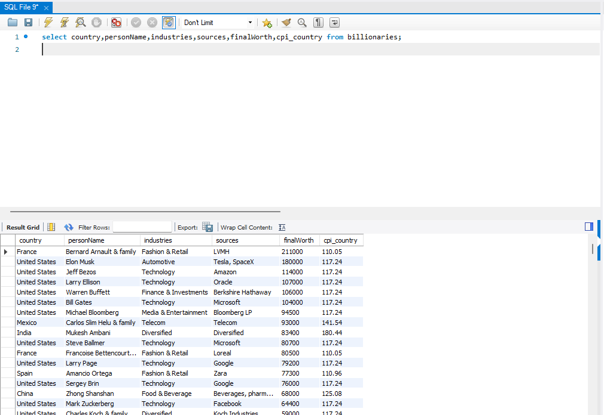
CPI
select country,personName,industries,sources,finalWorth,cpi_country from billionaries;

Slide 23
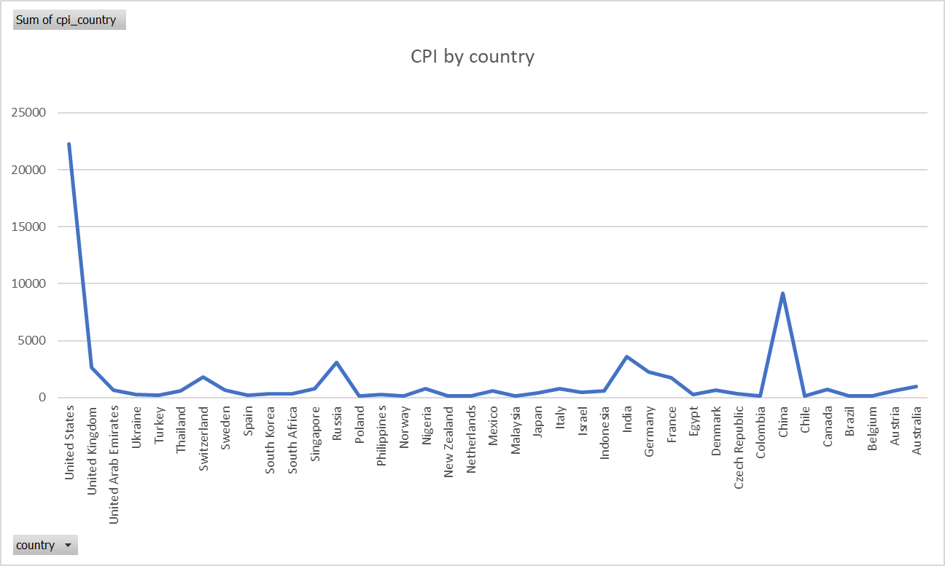
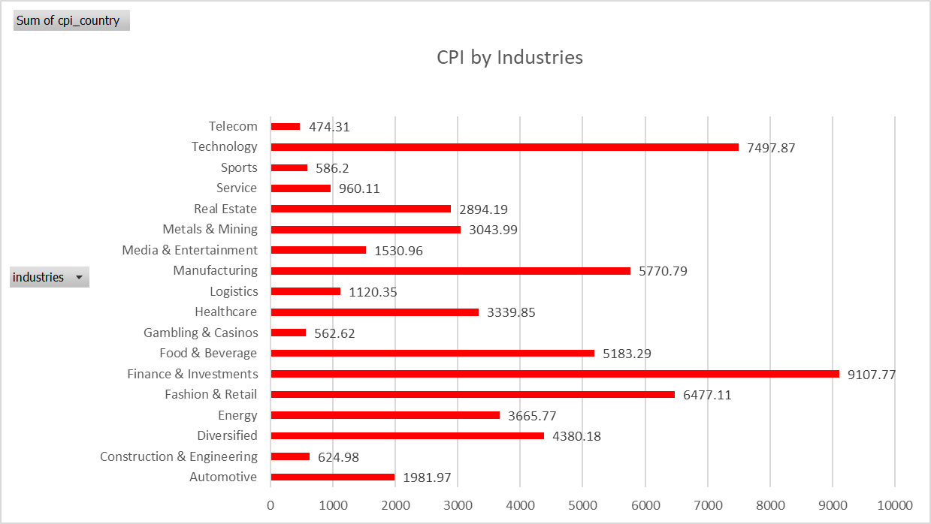
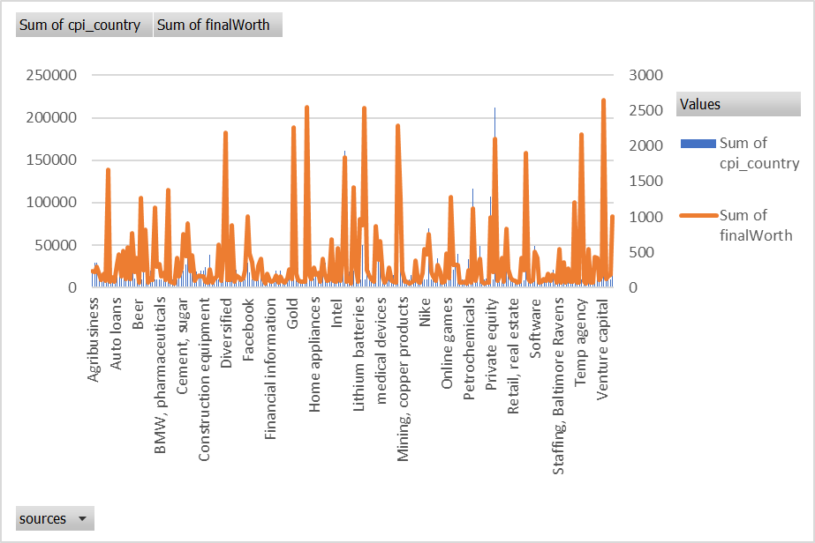
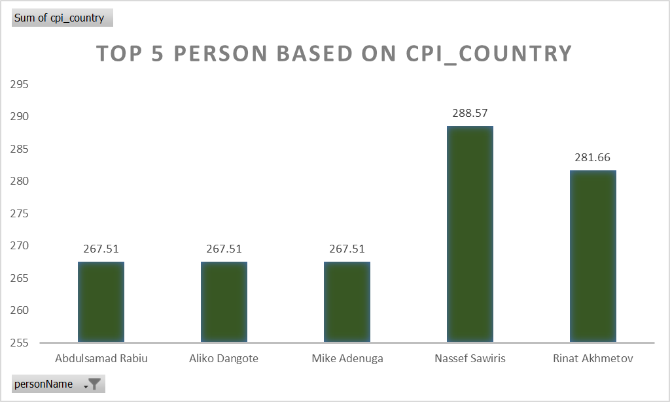
Total Cpi - Charts

Slide 24
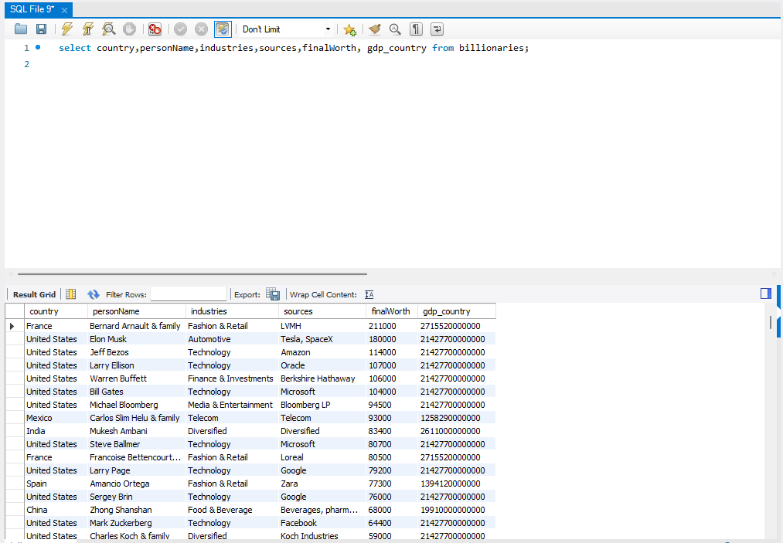
GDP
select country,personName,industries,sources,finalWorth, gdp_country
from billionaries;

Slide 25
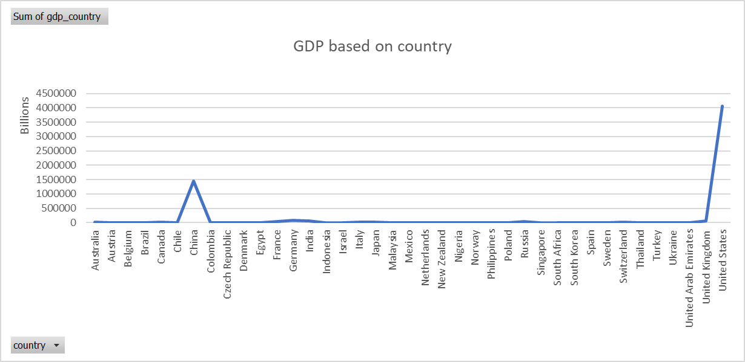
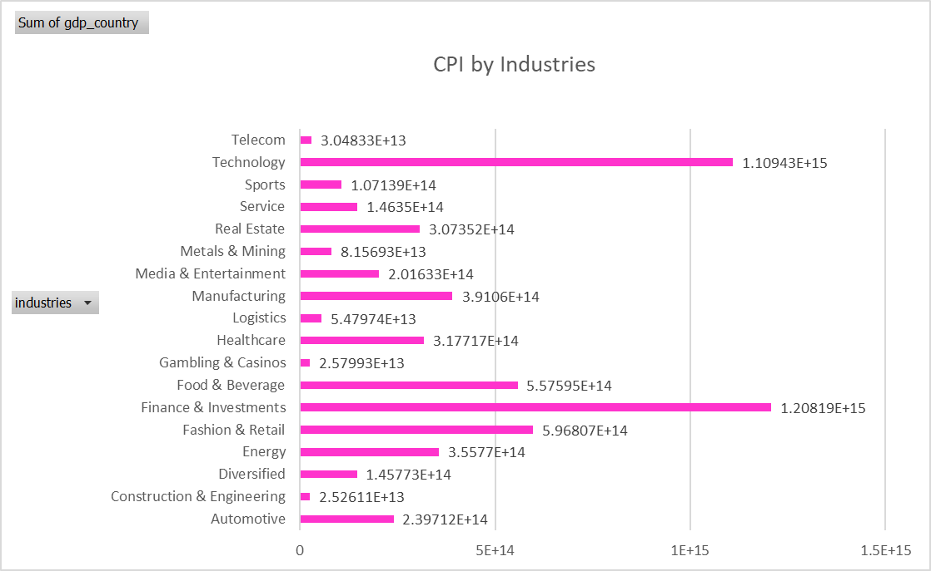
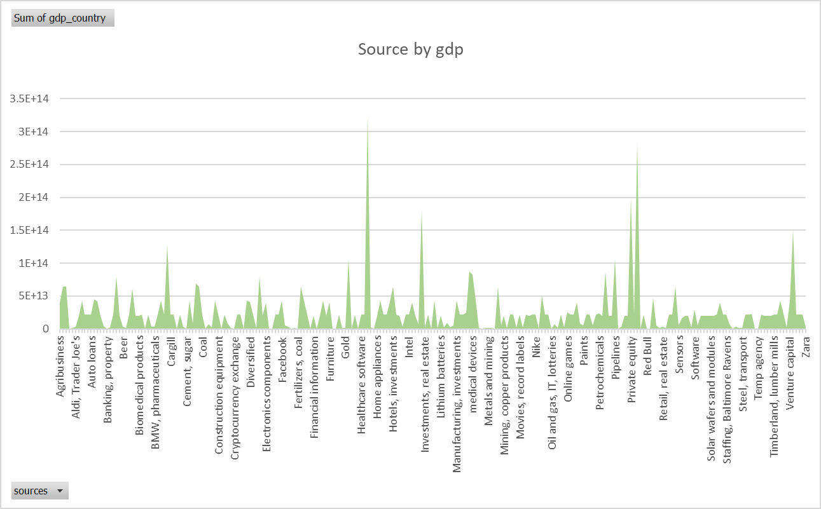
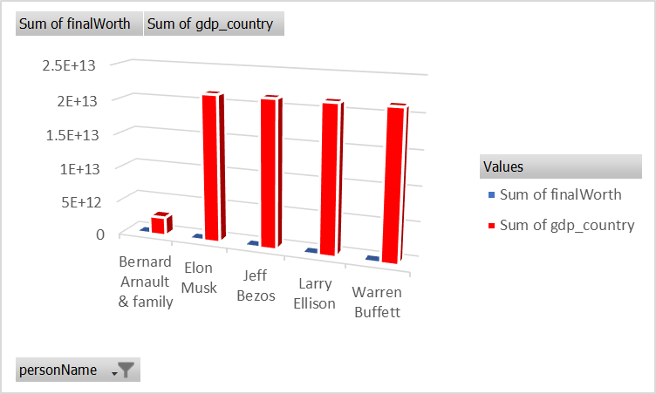
Total GDP-Charts

